Slide 1

Customer Shopping Behavior Analysis
This project analyzes customer shopping behavior using transactional data from 3,900 purchases across various product categories. Our goal is to uncover insights into spending patterns, customer segments, product preferences, and subscription behavior to guide strategic decisions.

Slide 2
Project Overview & Dataset Summary
Project Goal
Dataset Features
To leverage transactional data to understand customer behavior, informing strategic decisions related to product, marketing, and subscription strategies.
Customer demographics (age, gender, location, subscription status)
Purchase details (item, category, amount, season, size, color)
Shopping behavior (discount, promocode, previous purchases, frequency, review rating, shipping type)
Data Points
3,900 purchases analyzed

Slide 3


Exploratory Data Analysis: Our Process
Null / Special Check
Feature Engineering
Database Loading
Data Loading
Exploration
Our exploratory data analysis involved a systematic approach to prepare and clean the data for robust SQL analysis. This included loading data with pandas, exploring its structure and statistics, checking for data integrity issues, and engineering new features for deeper insights.

Slide 4
Key Business Questions & SQL Insights
Revenue by Gender
High-Spending Discount Users
Male customers generated significantly higher revenue.
Identified customers who used discounts and spent above the average purchase amount.
Female
75191
2
64
Male
157890
3
73
4
90
7
85
9
97

Slide 5
Product Performance & Shipping Insights
Top 5 Products by Average Review Rating
Average Purchase by Shipping Type
Gloves and Sandals lead with the highest average review ratings, indicating strong customer satisfaction.
Express shipping correlates with slightly higher average purchase amounts compared to standard shipping.
Gloves
3.86
Standard
58.46
Sandals
3.84
Express
60.48
Boots
3.81
Hat
3.80
T-shirt
3.78

Slide 6
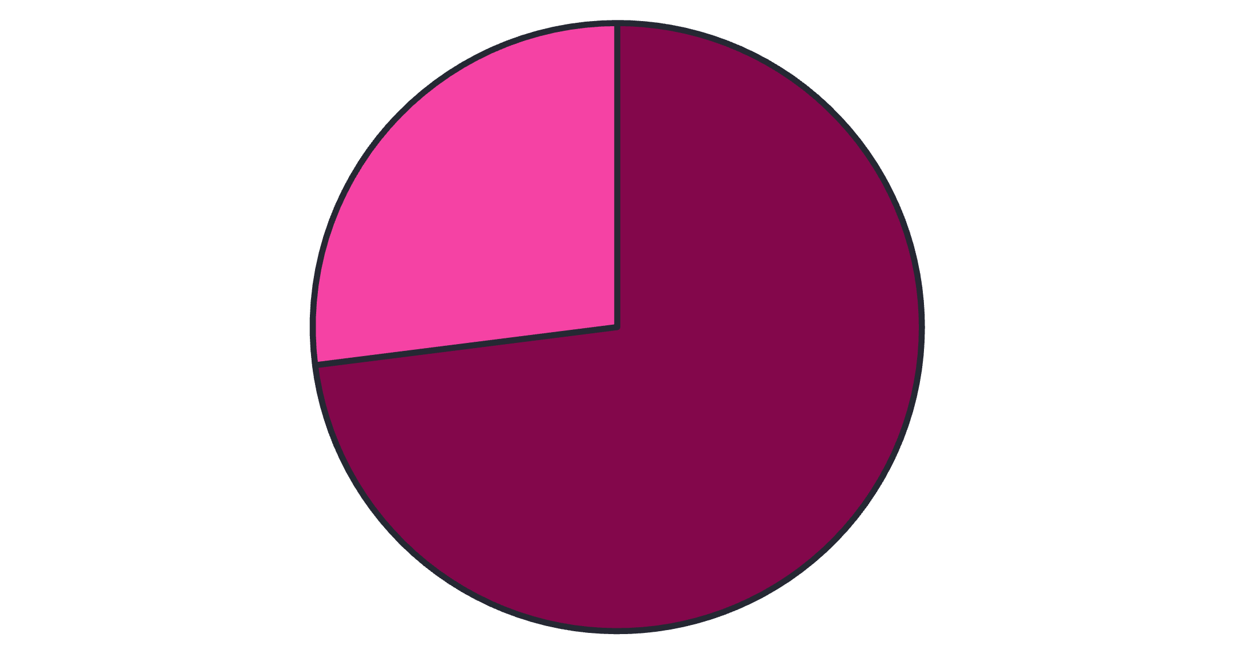
Subscription Status & Revenue Impact
Subscription Status vs. Revenue
Non-subscribers contribute significantly more to overall revenue, though subscribers show a comparable average purchase amount.
No
170436
59.87
2847
Yes
62645
59.49
1053
No
Yes

Slide 7

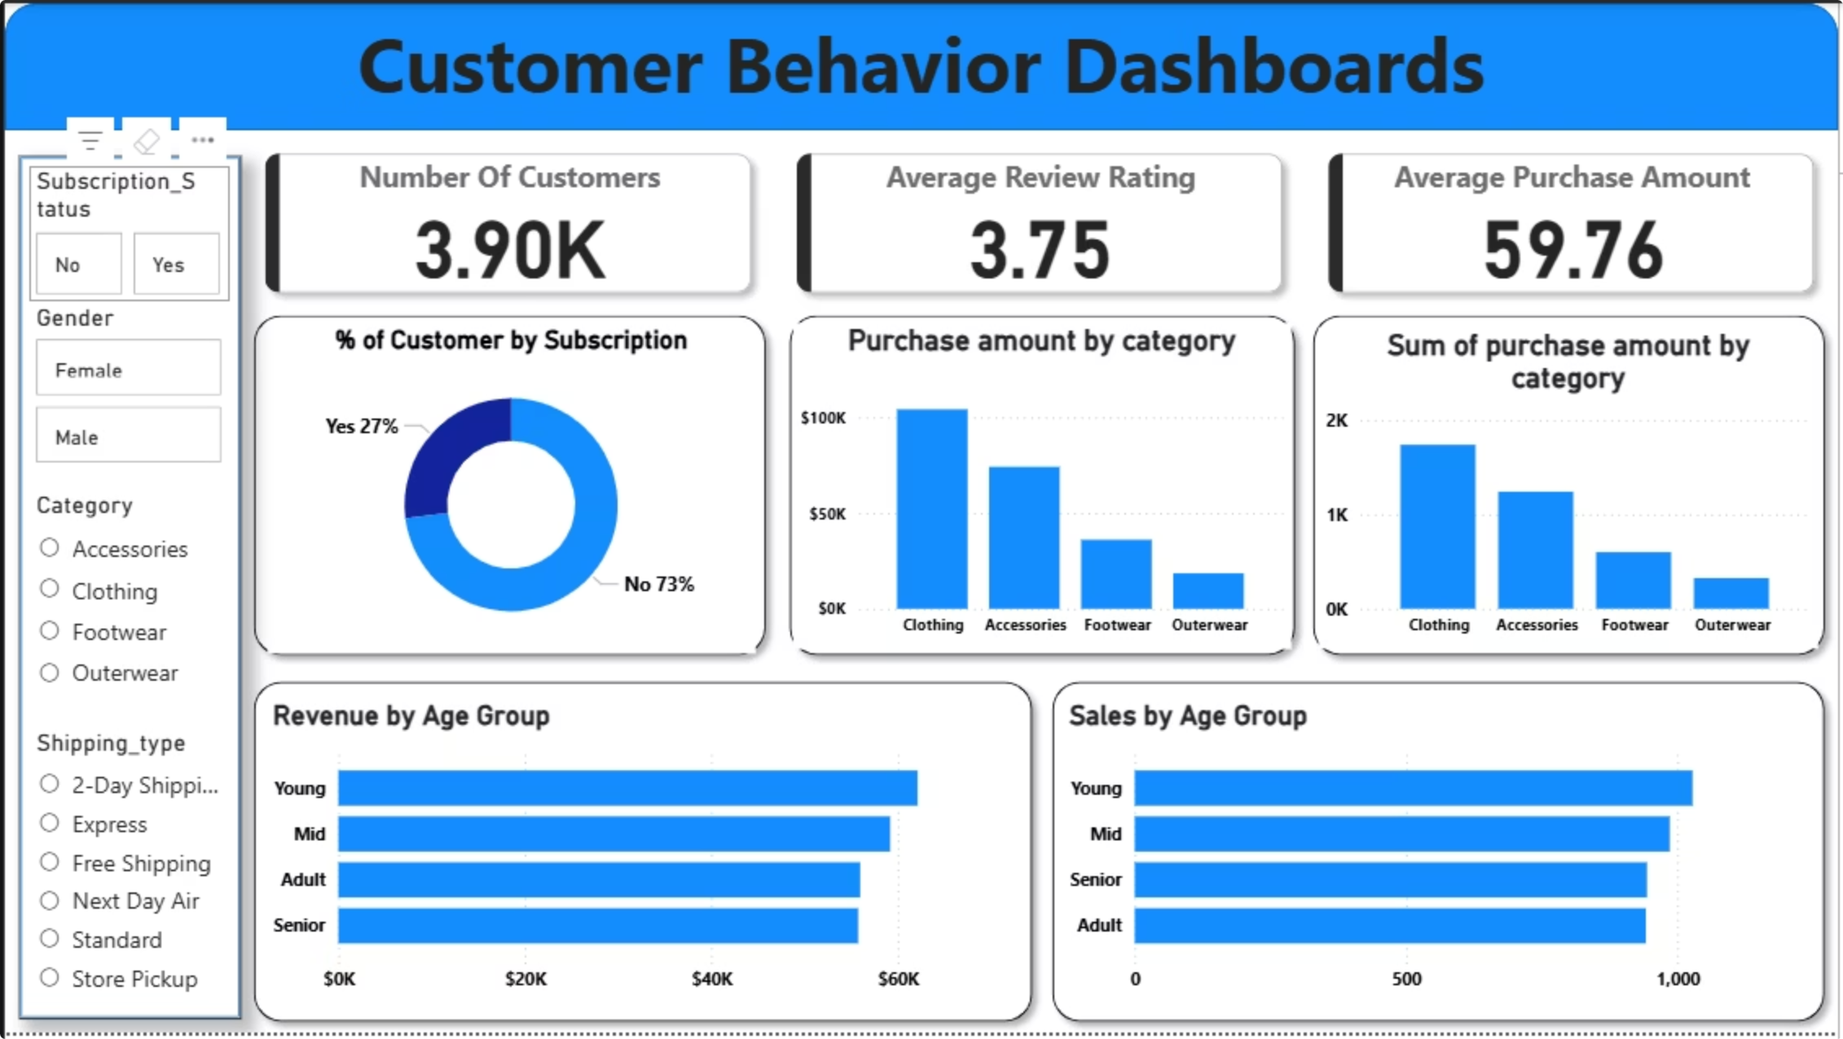
Power BI Dashboard: Customer Behavior at a Glance
The Power BI dashboard provides a comprehensive visual overview of customer behavior metrics, enabling quick insights into key performance indicators and trends.

Slide 8


Dashboard Key Metrics
3.90K
3.75
$59.76
Customers
Avg. Review Rating
Avg. Purchase Amount
Total number of unique customers analyzed.
Overall average satisfaction across all product reviews.
The average value of a single customer transaction.
27%
73%
Subscribed
Not Subscribed
Percentage of customers with an active subscription.
Percentage of customers without an active subscription.

Slide 9
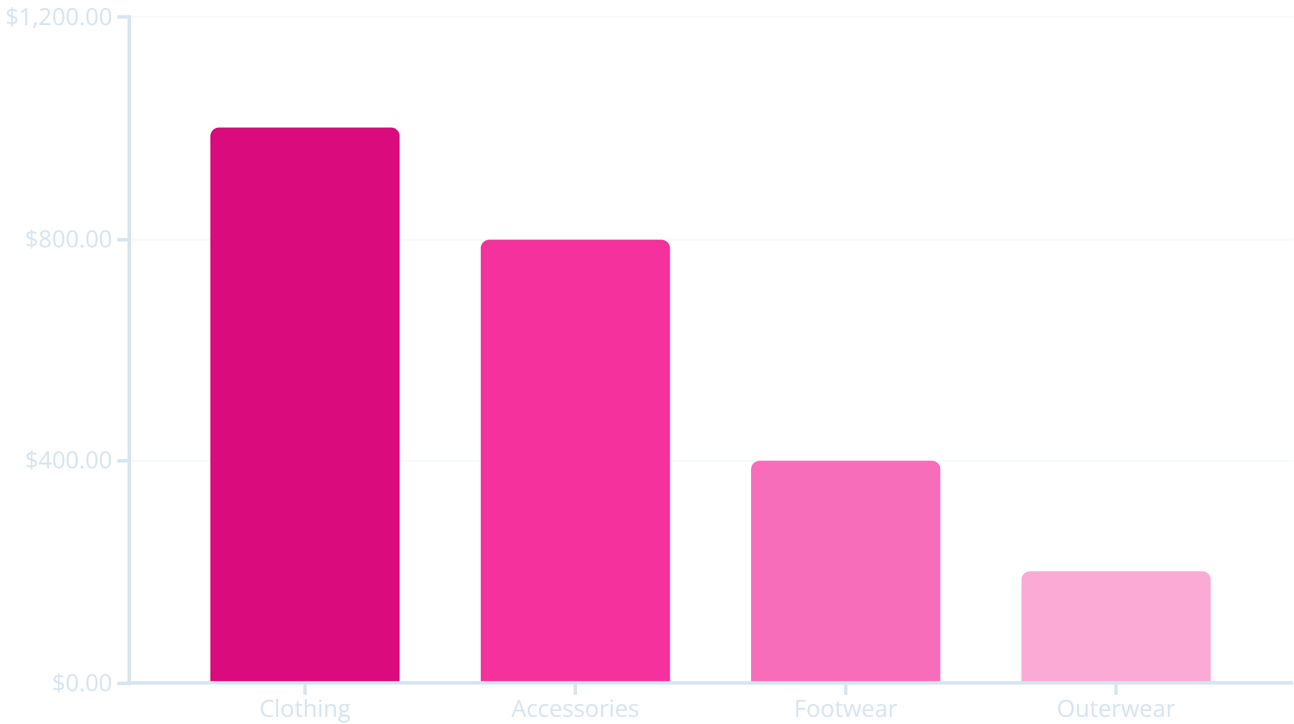
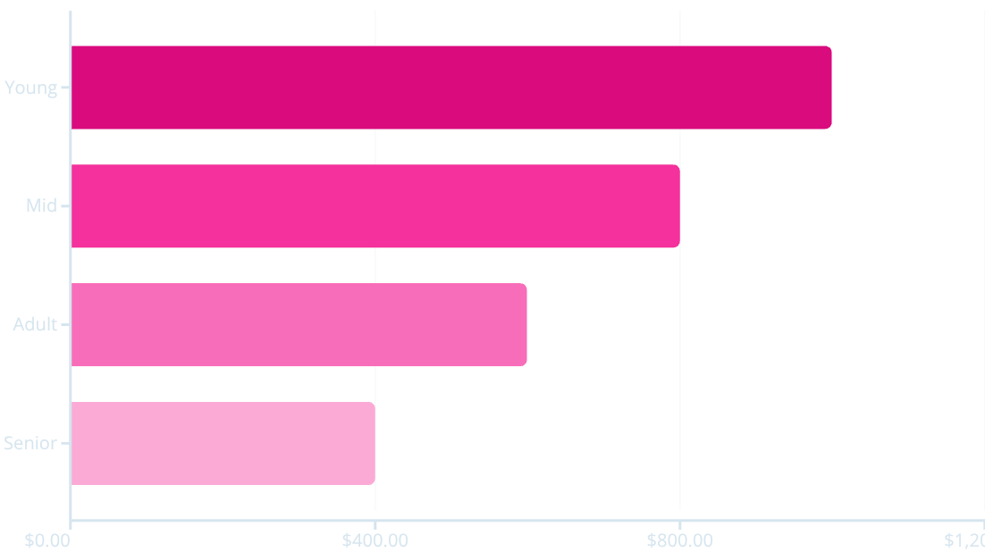
Purchase Trends by Category & Age Group
Purchase Amount by Category
Revenue by Age Group

Slide 10
Strategic Business Recommendations
Accelerate Subscription Growth
Deepen Customer Loyalty
Optimize Discounting Strategy
Enhance rewards for repeat purchasers, migrating them into the high-value "Loyal" segment.
Drive incremental revenue while protecting margins and long-term profitability.
Clearly communicate exclusive value propositions and premium benefits to subscribers.
Elevate Product Positioning
Sharpen Targeted Marketing
Prioritize top-rated and best-selling products across all marketing and promotional channels.
Concentrate spend on high-value demographics and customers preferring express shipping.

